Slide 1
Neuromend
By Tempest
An ICT313 Games Technology Project
Ary Bizar, Anopan Kandiah, Hannah Klinac, Alex Mlodawski, Bryan Yu

Slide 2
Outline
Introduction
Project background and client specification
The solution and what Tempest delivered
Project management
Technologies utilized (hardware + software)
Videos and live demonstrations
Final status
Future possibilities
Lessons learned Acknowledgements
Questions?

Slide 3
Introduction
Client: Shri Rai
Supervisor: Fairuz Shiratuddin
Tempest:
Ary Bizar (Bsc, Games Technology, Games Art and Design)
World designer, Modeller
Anopan Kandiah (Bsc, Computer Science, Games Technology)
Kinect development
Hannah Klinac (Bsc, Computer Science, Games Technology)
Leap Motion development, Project Management
Alex Mlodawski (Bsc, Computer Science, Games Technology)
Kinect development
Bryan Yu (Bsc, Computer Science, Games Technology)
Razer Hydra, Database
Project Name: Neuromend

Slide 4
Background + Client Specification
Stroke
How it affects the brain
Rehabilitation
Rewiring
Rehabilitation
Expensive
Tedious/boring
Limited

Slide 5
The Solution
Virtual Simulation
3 worlds
Devices
Oculus + Keyboard and mouse
Oculus + Razer Hydra
Oculus + Kinect
Oculus + Leap Motion
Sensitivity/Settings
Monitoring progress
Profiles on a database

Slide 6
Project Management
Methodology
Weekly team/supervisor meetings
Source code control
How the project was managed/how the team was managed

Slide 7
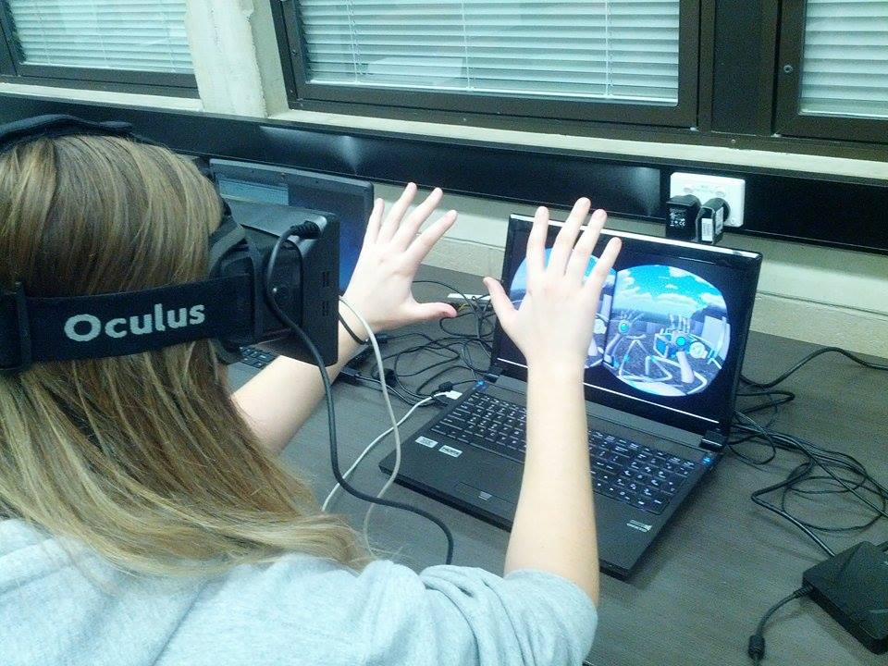
Technologies Utilized
Software
Unity
C#
API
SDK
3DS Max
Database
Hardware
Oculus Rift
Razer Hydra
Kinect
Leap Motion

Slide 8
Video and Live Demonstrations

Slide 9
Final Status
Virtual Simulation
3 levels
Devices
Database
Sensitivity/settings

Slide 10
Future Possibilities
Clinical use
Adding speech

Slide 11
Lessons Learned
Devices
Beta products
Driver clashes
Versions/compatability
Designing movements/gestures
Version control (levels + devices)
Communication
(beyond IT; teamwork communication, time management)

Slide 12
Acknowledgements
Client – Mr Shri Rai
Supervisor – Dr Fairuz Shiratuddin

Slide 13
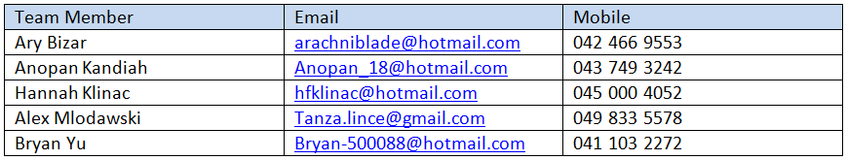
Questions?

